Slide 1

WELCOME

Slide 2





group
KHYRUL ALAM
22-49398-3
BSc CSE
S. S. ZOBAER AHMED
22-49415-3
BSc CSE
SADIQ AL ARAF
23-50890-1
BSc CSE
MD MUNTASSIR
23-50290-1
BSc CSE
AFNAN BIN ISLAM
22-49350-3
BSc CSE

Slide 3

Relationship Between Study Hours And Academic Performance

Slide 4

THE
RESEARCH
QUESTIONS
What is the relationship between study hours and academic performance among students?
Why is understanding this relationship important for educational practices and student success?

Slide 5

Key Studies on Study Habits and Academic Performance: - Karweit (1983) - Arum and Roksa (2011) - Schuman et al. (1985) - Plant et al. (2005) - Hulleman et al. (2010)

Slide 6

METHODOLOGY
SURVEY DESIGN
DATA ANALYSIS
FORMAT
DATA COLLECTION
INSTRUMENT

Slide 7
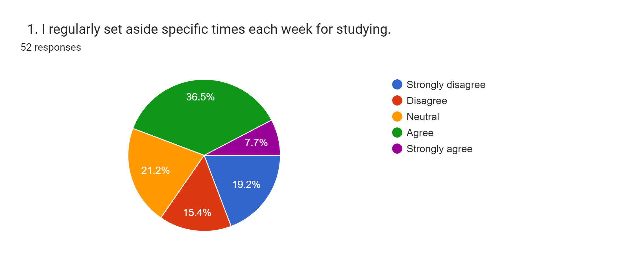
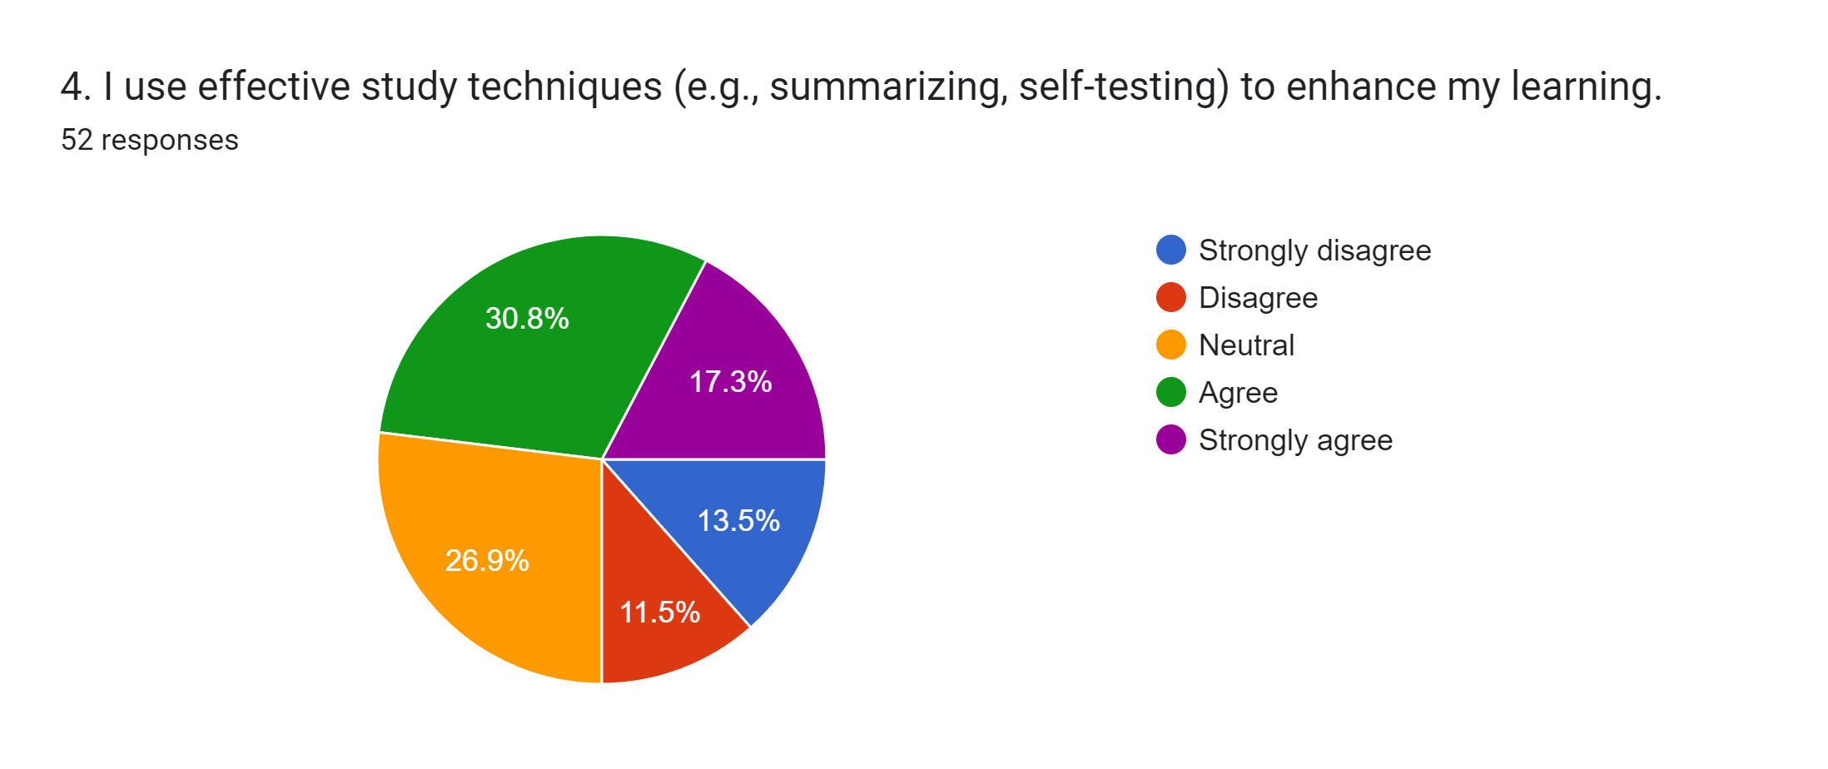


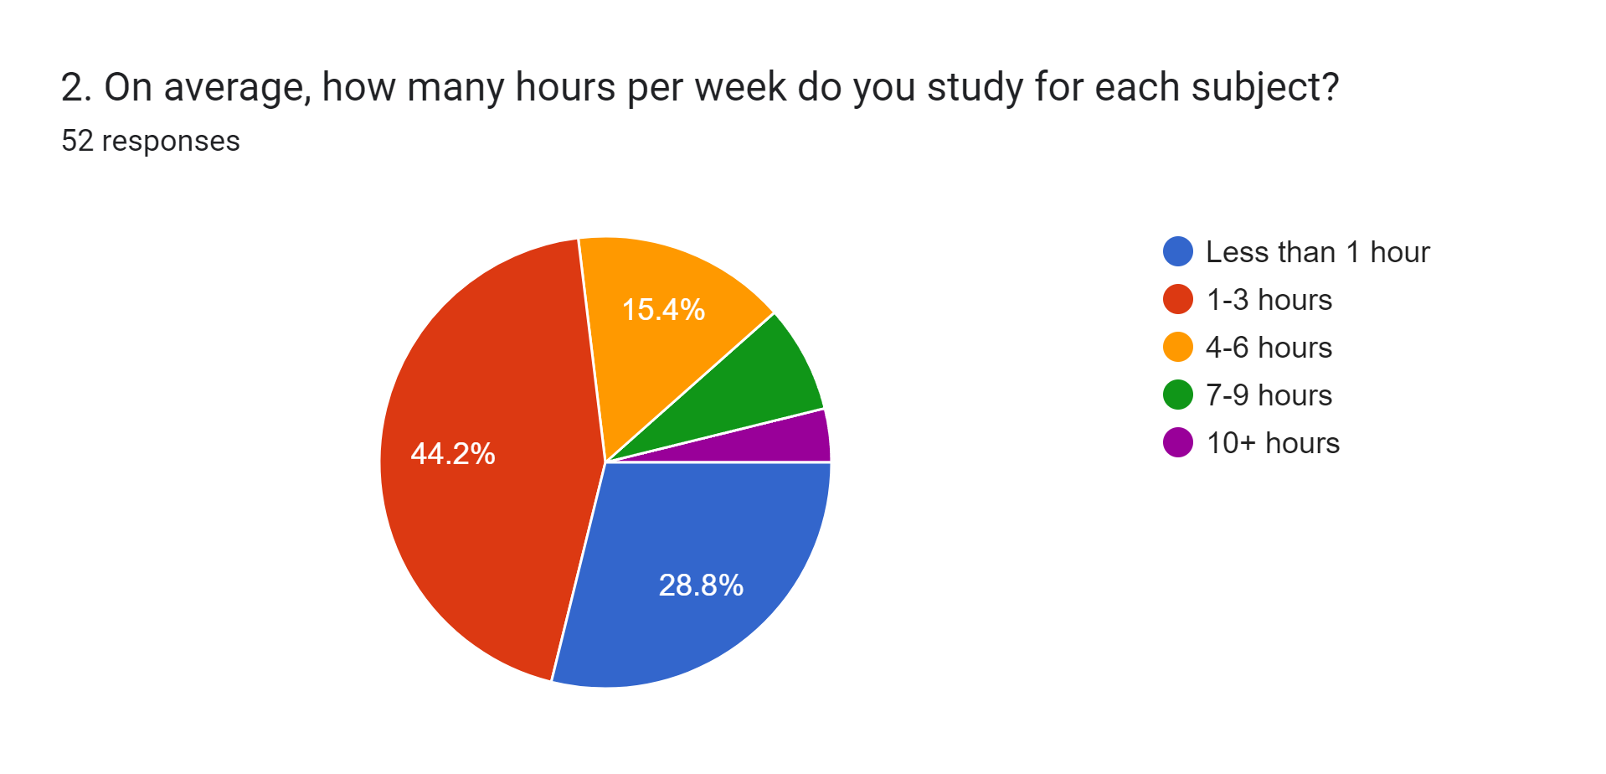
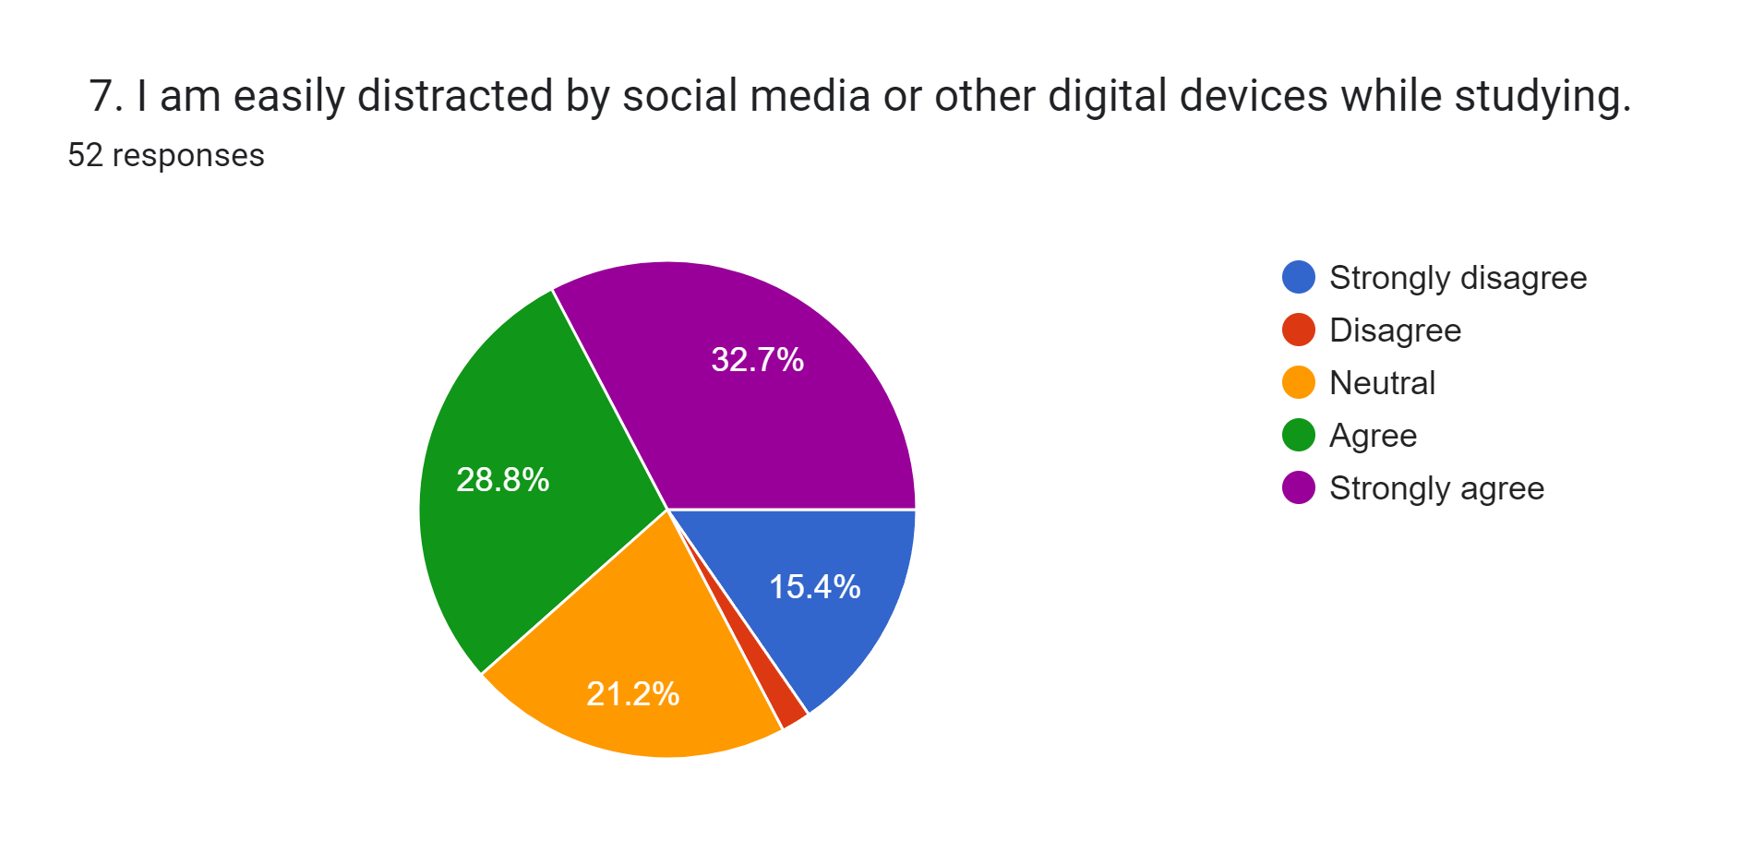
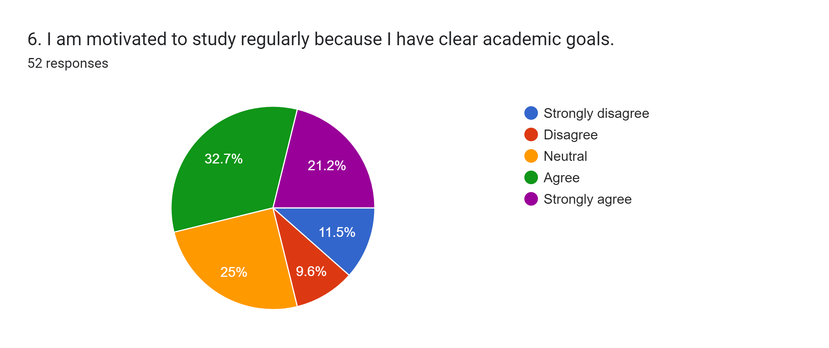
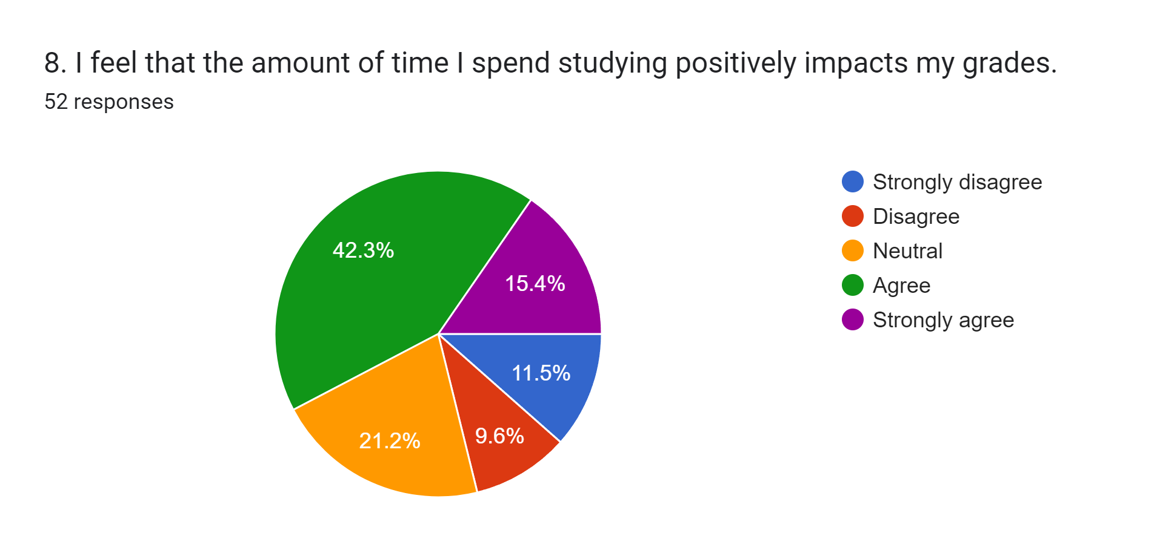
FINDINGS
TOOLS & LANGUAGE
Mean: 10.4
Median: 10
Variance: 24.24
S.D. : 4.92
Mean: 10.4
Median: 9
Variance: 15.44
S.D. : 3.93
Mean: 10.4
Median: 8
Variance: 59.4
S.D. : 7.71
Mean: 10.4
Median: 11
Variance: 31.84
S.D. : 5.64
WHAT’S WE ACTUALLY FIND?
Mean: 10.4
Median: 11
Variance: 19.84
S.D. : 4.45
Mean: 10.4
Median: 8
Variance: 37.8
S.D. : 6.15

Slide 8
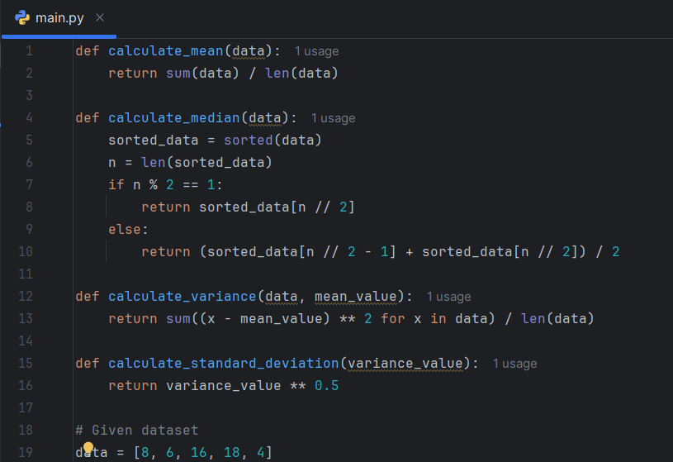
FINDINGS
THE ALGORITHM
Mean: 10.4
Median: 10
Variance: 24.24
S.D. : 4.92
Mean: 10.4
Median: 9
Variance: 15.44
S.D. : 3.93
Mean: 10.4
Median: 8
Variance: 59.4
S.D. : 7.71
Mean: 10.4
Median: 11
Variance: 31.84
S.D. : 5.64
WHAT’S WE ACTUALLY FIND?
Mean: 10.4
Median: 11
Variance: 19.84
S.D. : 4.45
Mean: 10.4
Median: 8
Variance: 37.8
S.D. : 6.15

Slide 9

Discussions
INTERPRETATION
IMPLICATIONS
LIMITATIONS
RECOMMENDATIONS

Slide 10


Slide 11


